Slide 1

360.car
Augmented reality, for a better shopping experience
Wail Ayad - Poly
Rui Guo - Mcgill
Édouardo Magini - HEC
Émile Normand – ETS

Slide 2

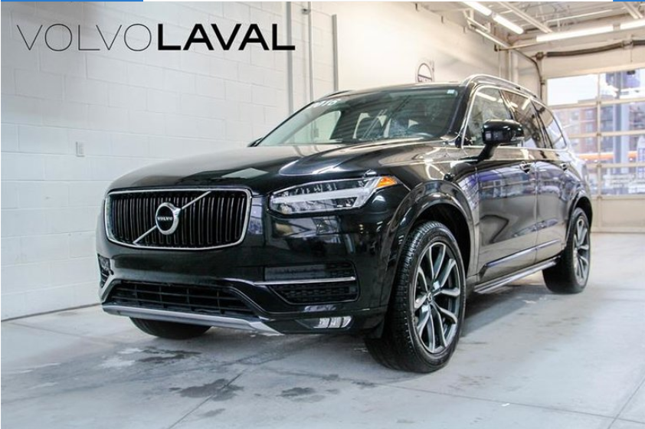
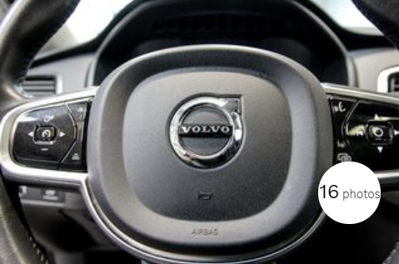
360.CAr – revolutionizing online customer experience
Before
Pictures aren’t always reprensentative
Not every details about cars are seen
Inventory limitation: Customer’s are limited to the inventory of the dealership

Slide 3
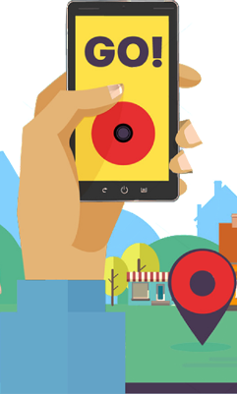

360.CAr– revolutionizing online customer experience
After
Augmented reality gives customer accurate visual representation of their potential next purchase
A lot more details are available
No inventory limitation, every customer has access to the main database, which contains every car

Slide 4

360.CAr– revolutionizing online customer experience
How it works – Augmented reality
Android App built with Android Studio, ARCore and SQL
Allows 3D visual reprensentation
Functionalities built in include: Select cars, Buy, Test drive, etc.

Slide 5

360.CAr– revolutionizing online customer experience
How it works – Accessing Database
Accesssing SQL database from servers
Linking the database our new app

